Slide 1
Demand Forecasting for Automotive Products Using Time Series Analysis and Smoothing Techniques
Mahendhar Mittapally
Kaden rackely
Deven sandhan

Slide 2

Introduction
Store: 1
Product: Automotive
Goal: Perform demand forecasting by analyzing past sales data and applying various forecasting methods like MA,SES and HWES

Slide 3
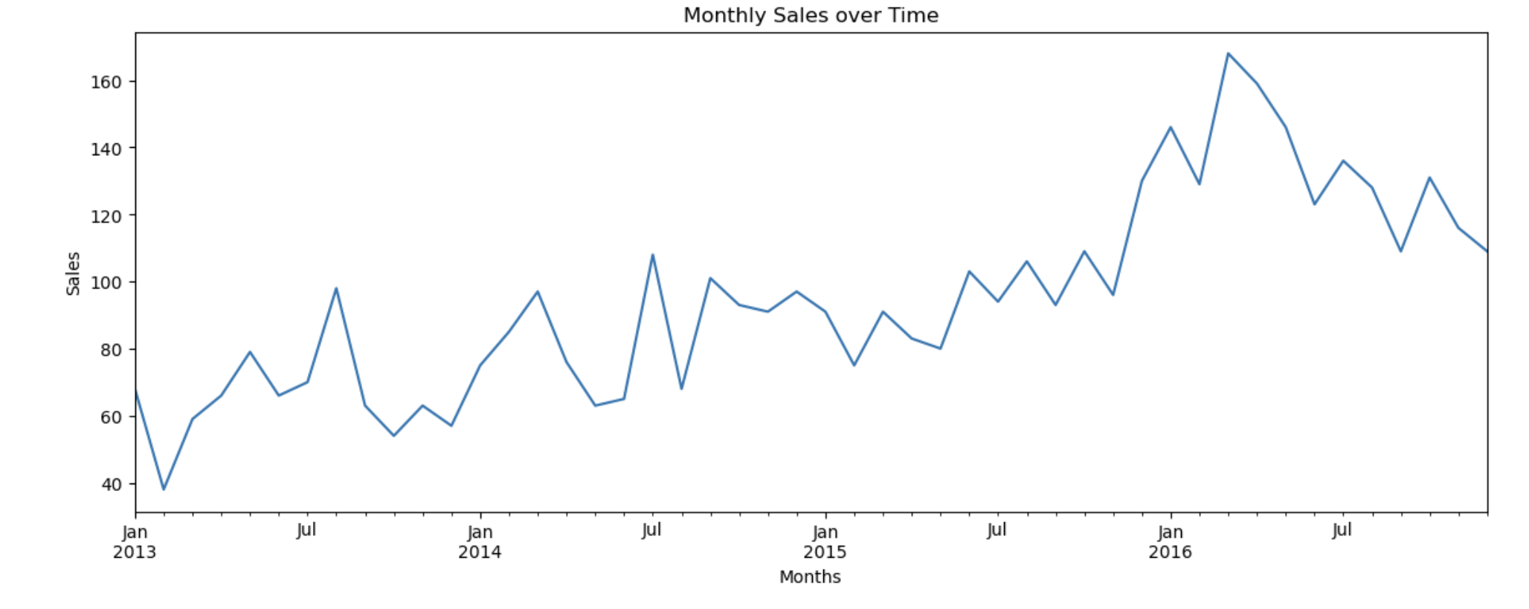
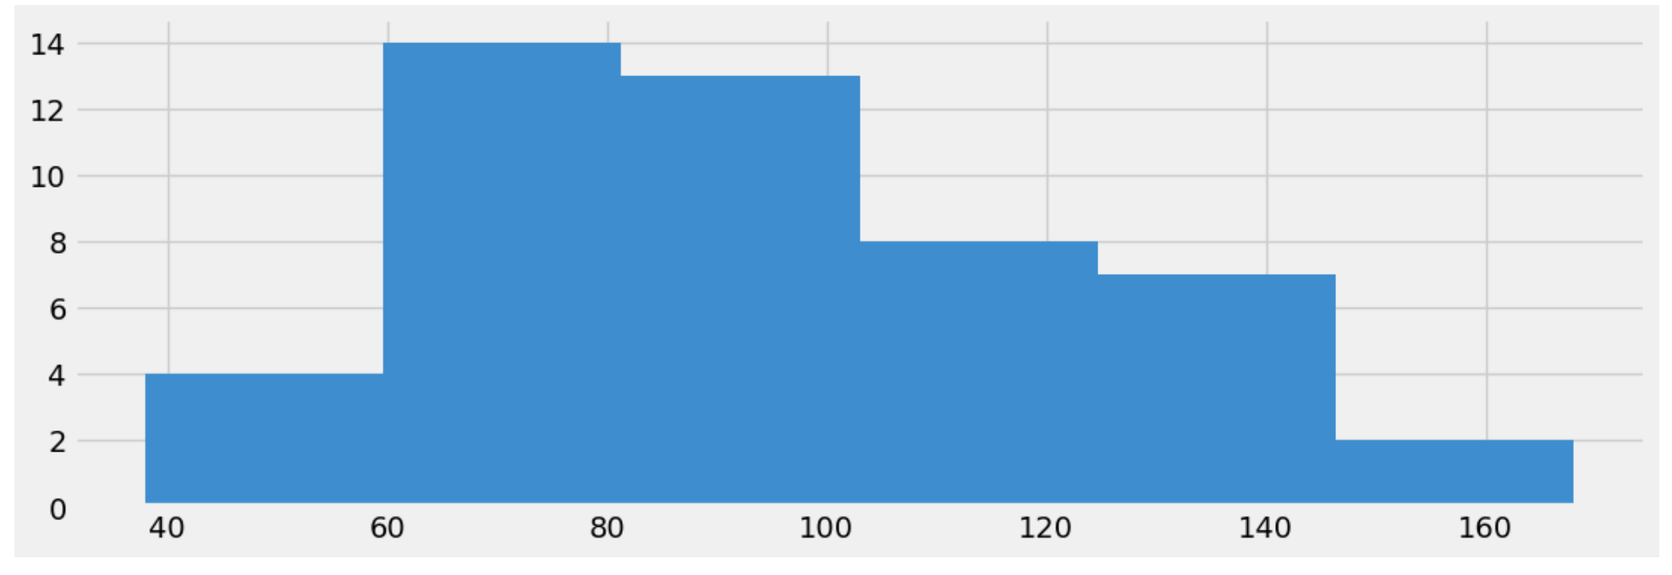
Exploratory Data Analysis (EDA)
Overall, Sales: Visualized using histogram and line plot.
Monthly Aggregation: Grouped data monthly for a clearer trend.
Decomposition: Analyzed components like trend and seasonality to understand underlying patterns.

Slide 4
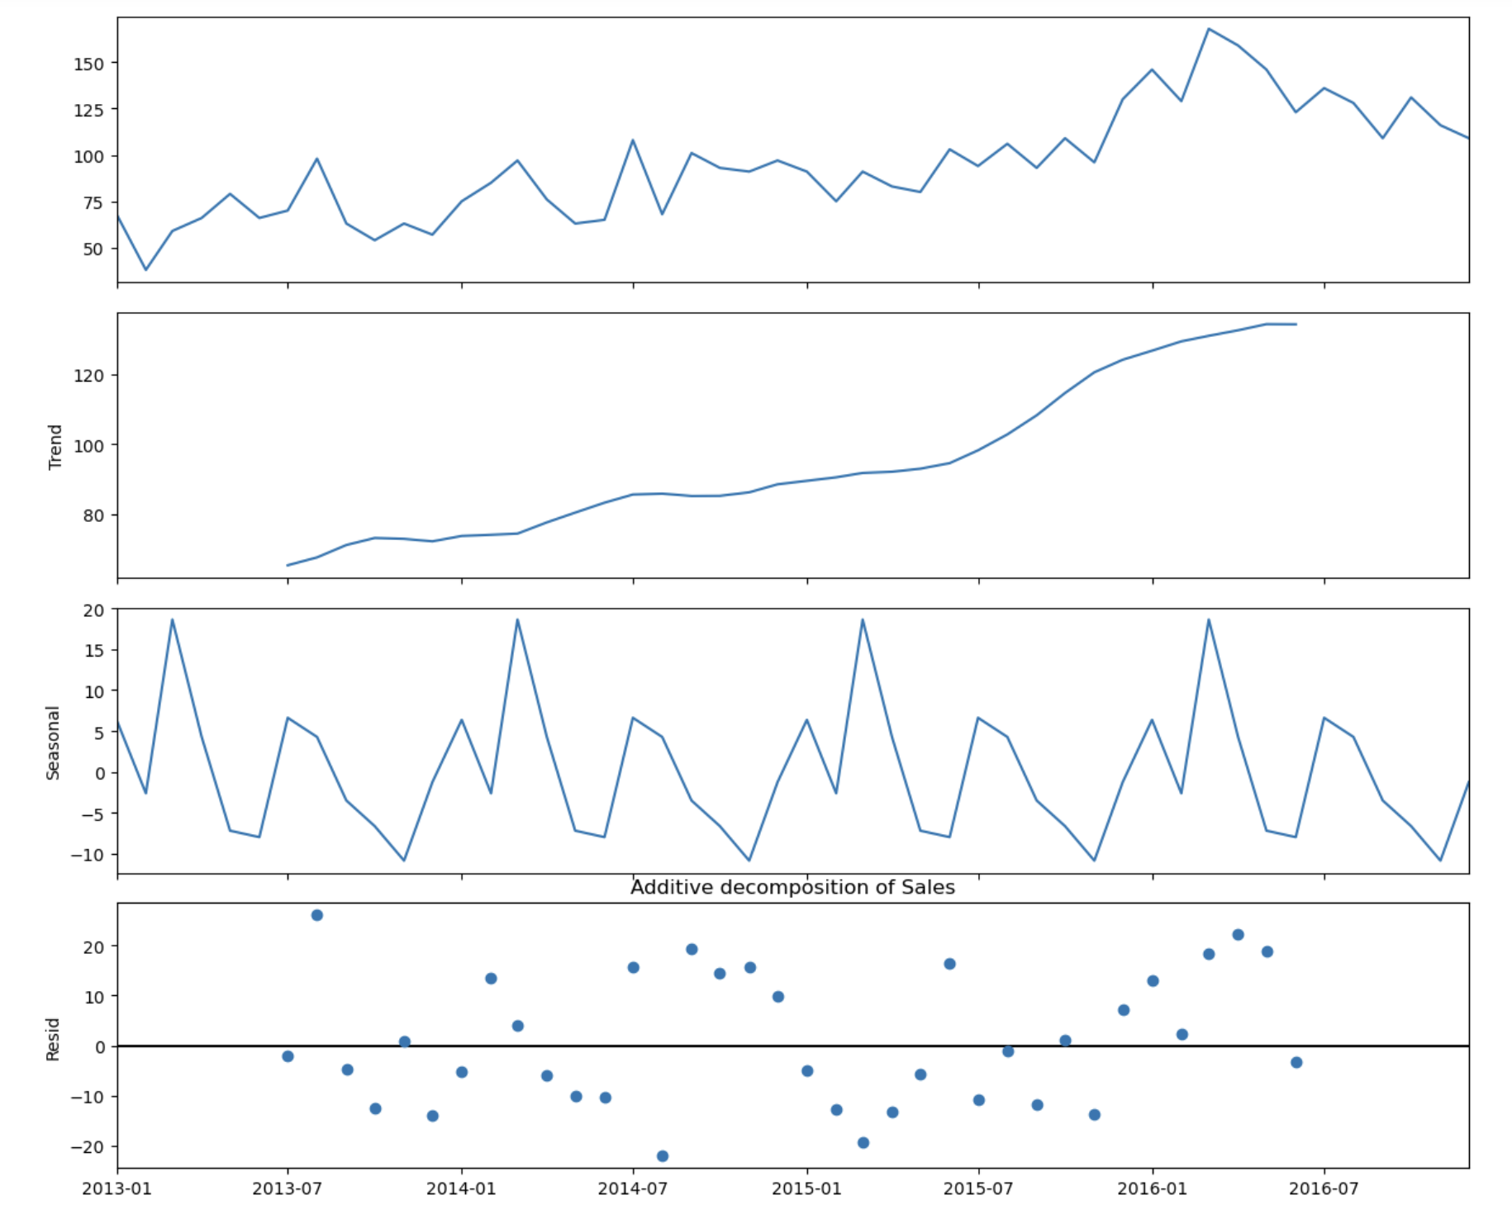
additive decomposition model
Demand = level + trend + seasonal + residual
Trend line is linear means sales increase over the period
Seasonal sales are high in the month of MAR and SEP and low in FEB and NOV
Residual actual sales were higher than expected based on trend and seasonality alone. Notably, mid-2016 and Lower in 2014-15

Slide 5
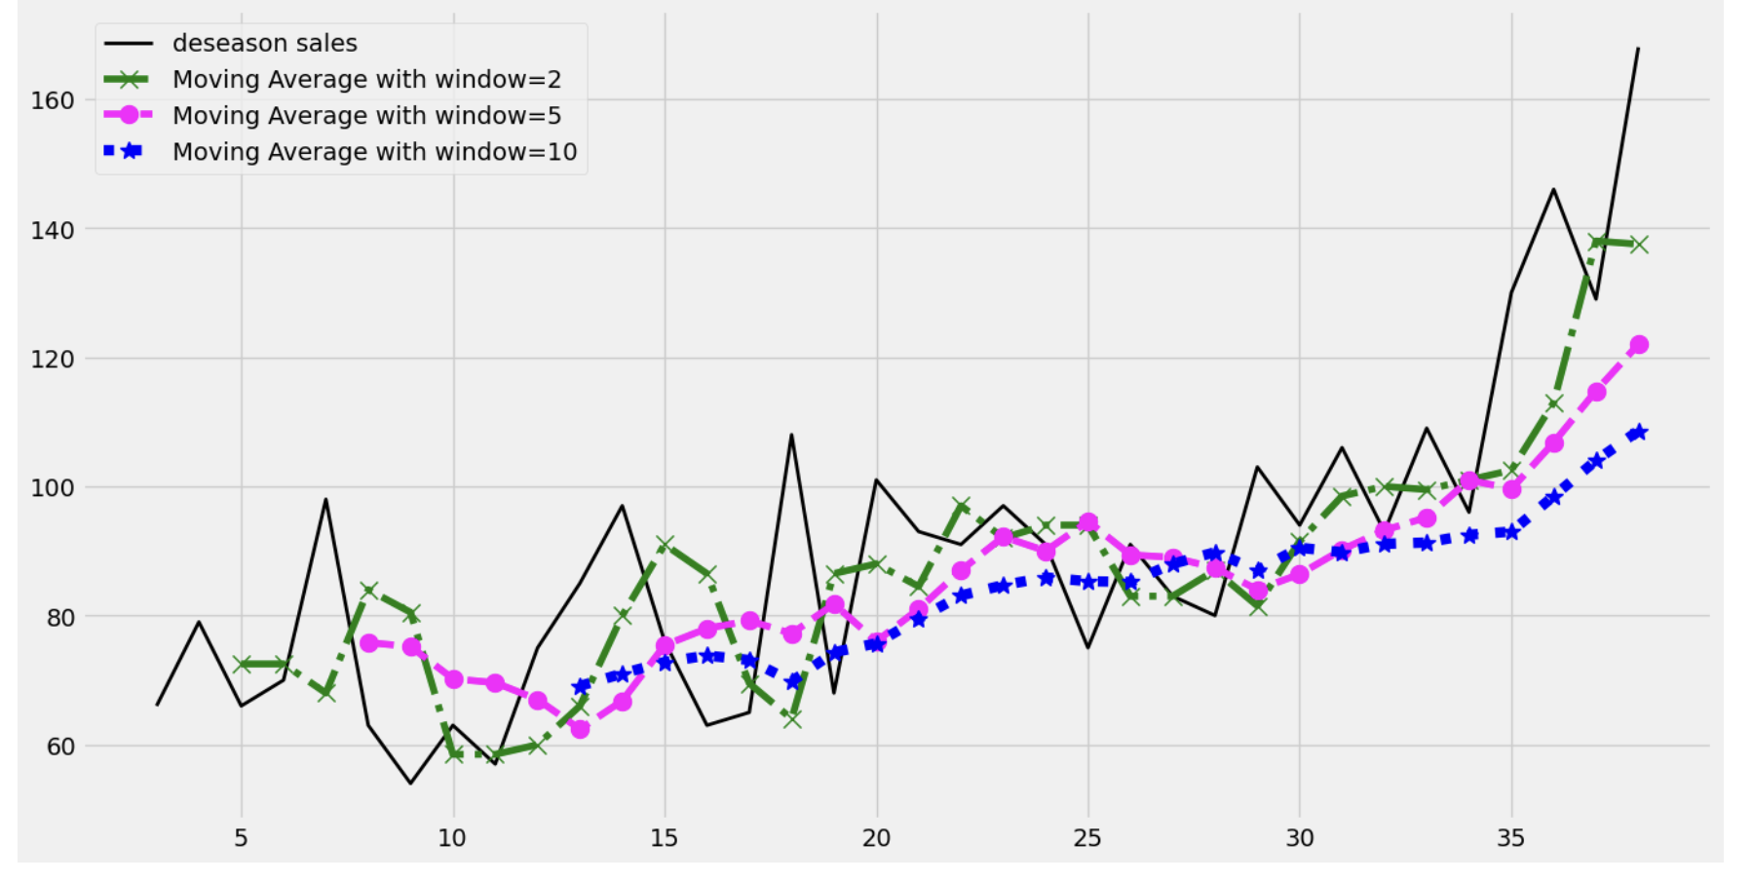
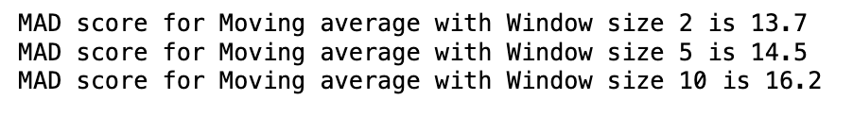
Moving Average (MA) Train data
Applied MA method with de-seasoned sales with different windows of 2,5,10
Based on the MAD score of MA, Window size 2 is the best Window to forecast with lowest Mean Absolute Devaiation

Slide 6
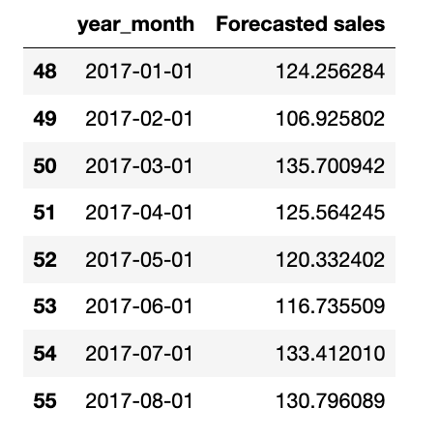
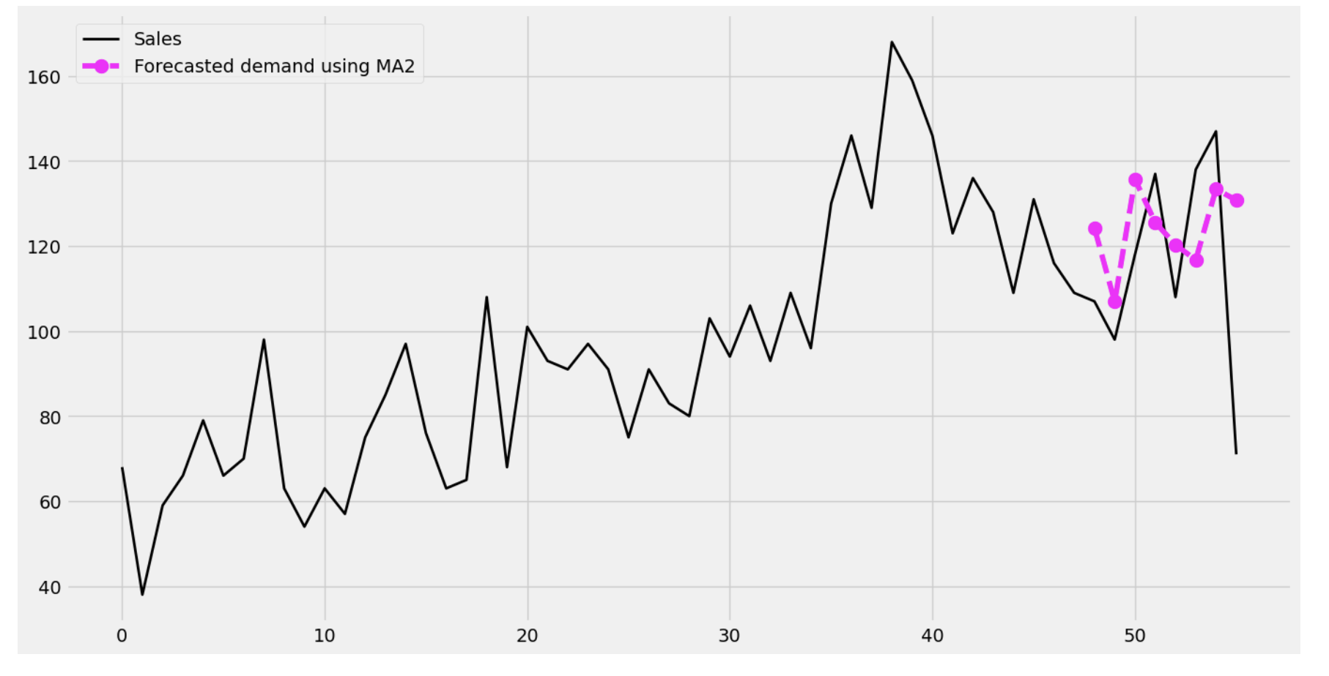
Forecast of MA (Test Data)
The test data covers January 1, 2017, through the remaining dates in the dataset.
The forecasted sales were evaluated against actual sales for this period.
The Testing error of Mean Absolute Deviation (MAD) was calculated as 20.28, indicating the model’s average prediction error.

Slide 7
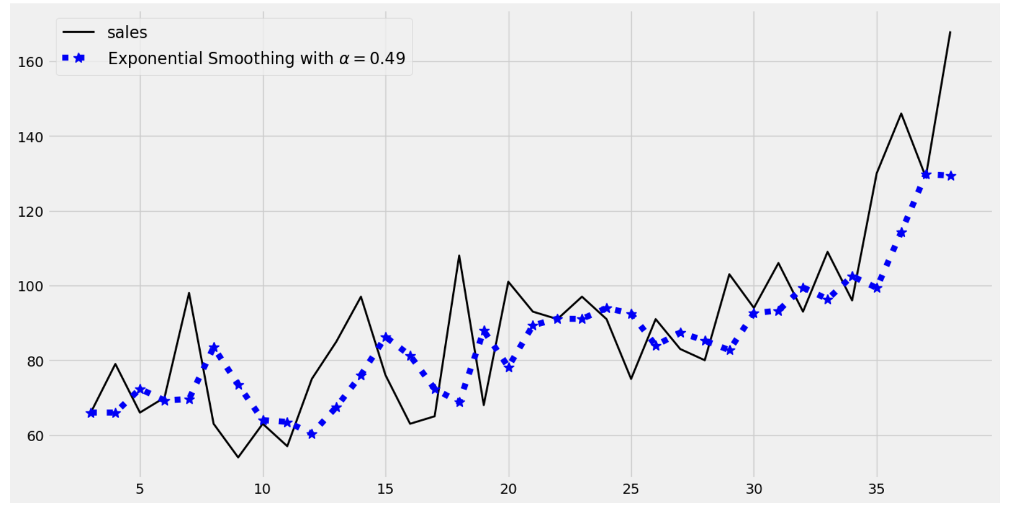
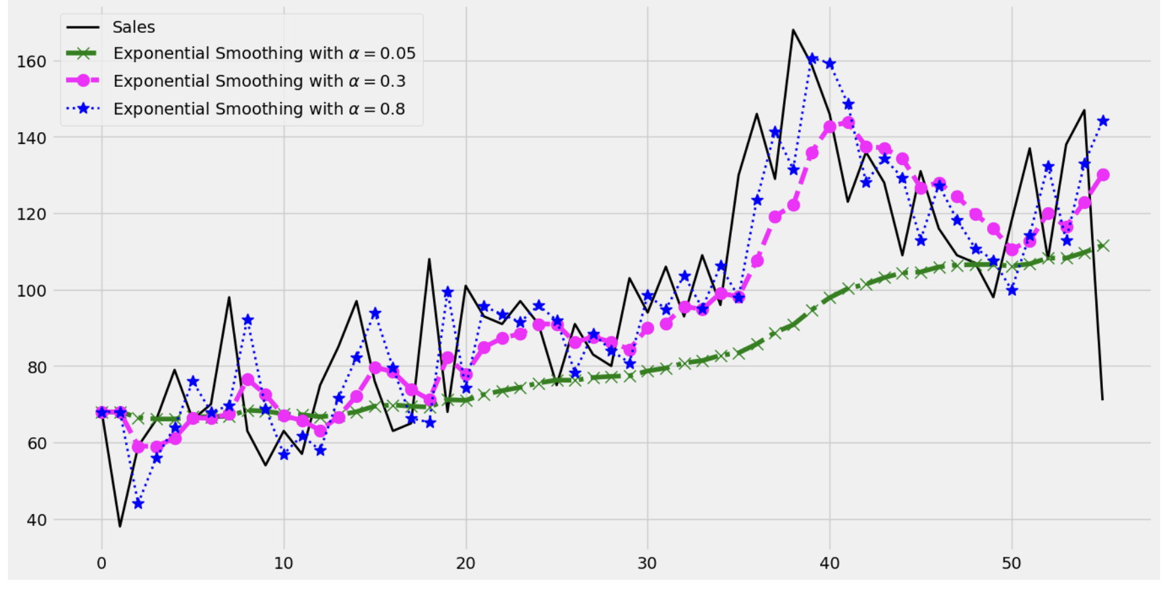
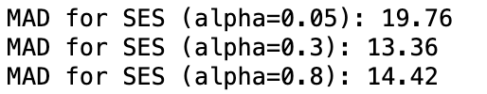
Simple Exponential Smoothing (SES)
Purpose: Assigns greater weight to recent demand values, balancing recent trends with historical data
Models were tested with smoothing factors of 0.05, 0.3, and 0.8 to find the best fit for the demand data.
From the analysis of MAD SES, the alpha 0.3 is lowest and the best fit to forecast to get the accurate results

Slide 8
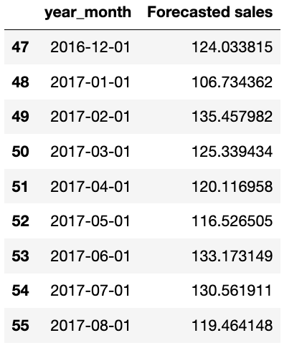
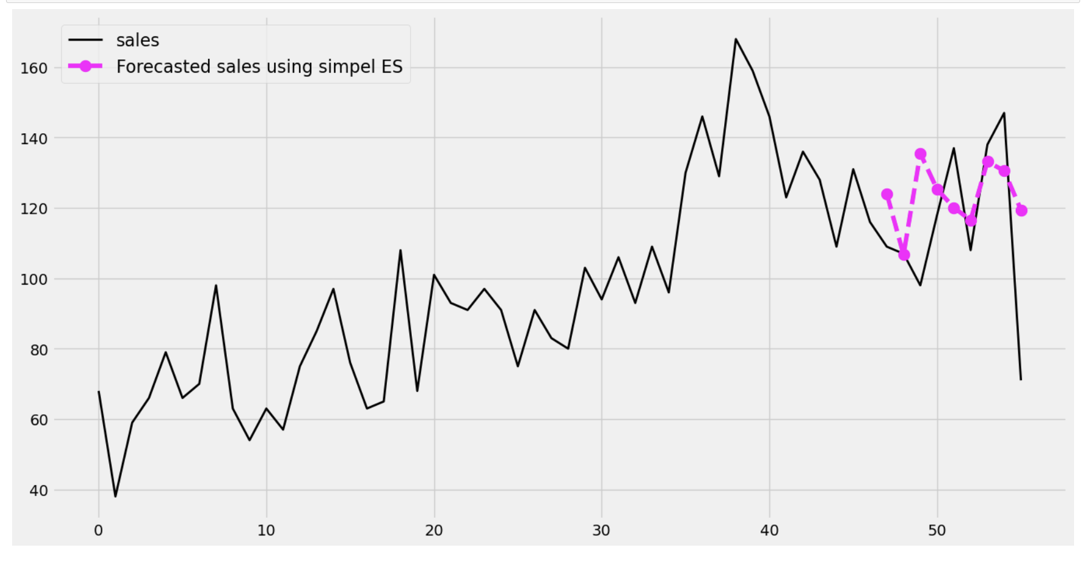
Forecasting with SES (TD)
Testing Error of MAD value = 17.25

Slide 9
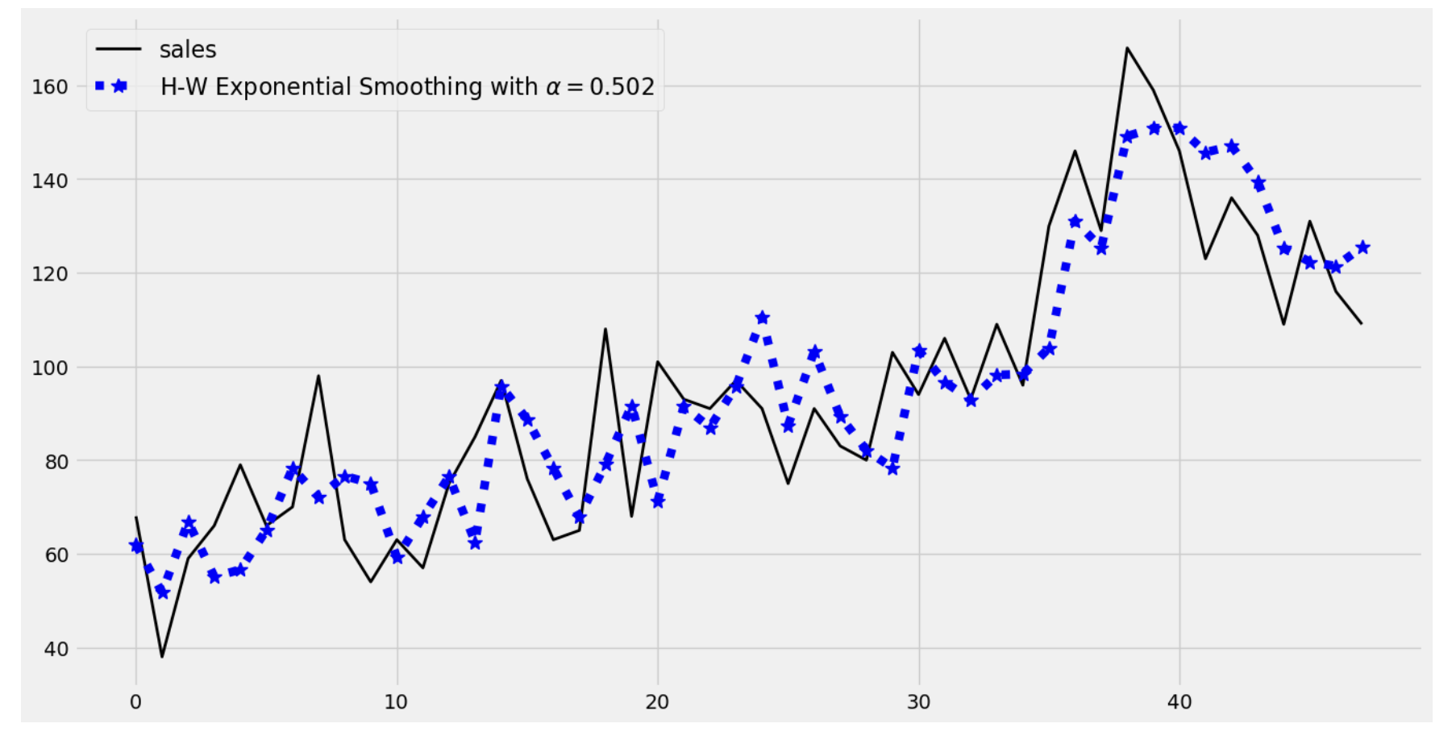
Holt-Winters Exponential Smoothing (HWES)
Purpose: Captures both trend and seasonality, making it well-suited for data with cyclical demand patterns.
An additive model was chosen based on the decomposed seasonality and trend observed in the data.

Slide 10
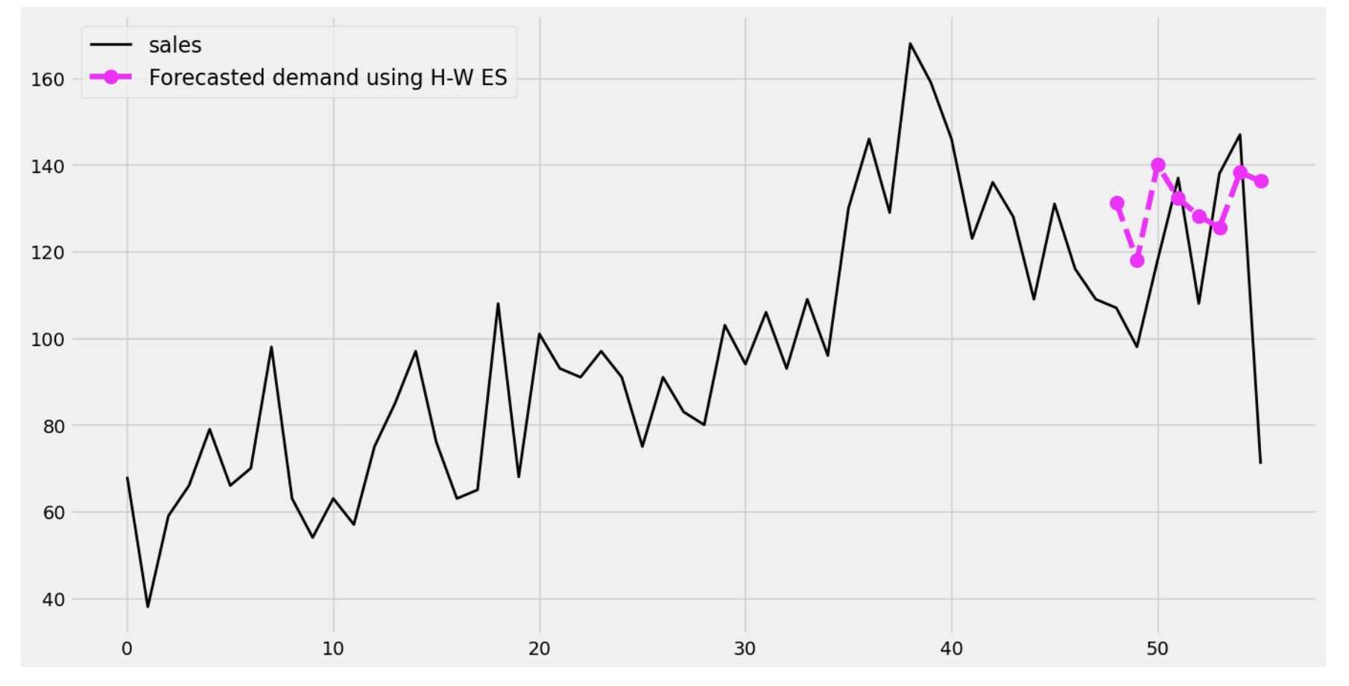
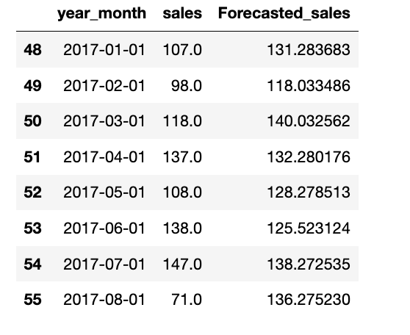
Forecast of HWES (test Data)
Testing error of MAD value of HWES is 22.23

Slide 11

Conclusion
From the above analysis of Mean Absolute deviation(MAD) we choose the Simple Exponential Smoothing (SES) is the best method among MA and HWES with the MAD values of 17.25
the next 3 forecasted values of the best method of SES are (100.1,105.4, 100)
Based on the forecasted values we can conclude the model works accurately with the alpha 0.3.

Slide 12

Further Improvements
ARIMA (Auto-Regressive Integrated Moving Average): ARIMA is effective for time series data with non-seasonal and seasonal components. By capturing both, it could enhance the accuracy of our forecast.
Holt-Winters Multiplicative Model: Since the current model uses an additive HWES model, switching to a multiplicative model could better capture demand patterns if the seasonal effects change proportionally with the level of demand.
Machine Learning Models: Consider trying machine learning models like Random Forest or Neural Networks to capture non-linear relationships and interactions within the data, especially if more features (external variables) are available.
This Photo by Unknown Author is licensed under CC BY-SA-NC

